Slide 1

Climate Impact Planning & Response
Due Diligence for Your Organization
Will Ernst
Tahoma Environmental
PO Box 39184 Lakewood, WA 98496
wernst@tahomaenvieonmental.com
206.250.4586

Slide 2
Purpose – A Look at Options for Managing Climate Change
Content
Regardless of cause, weather and climate are changing
possible actions in response – mitigation and adaptation
available data and planning tools
Risk/cost/benefit tradeoffs affect all stakeholders
  impact forecasting and risk pricing
  litigation trend – “Failure to Adapt” claims
  strategies to manage impacts and risks or identify opportunities
Emerging global ESG management framework
documenting fiduciary preparedness – Environmental, Social & Governance
  financial disclosure basis for comparative assessments
Preview: preparation, data, action and accountability

Slide 3
A Quick Summary
Changes in weather and climate may come at us sooner than we think.
Impacts and risks are very location- and asset-specific.
Data, tools and the experience of others are available around which to plan.
Stakeholders and many others now expect active climate management.
Globally-accepted ESG standards for managing climate are available.
A monitored risk baseline will allow better forecasting of future impacts.
Climate change is a problem to solve – and an opportunity to manage.

Slide 4
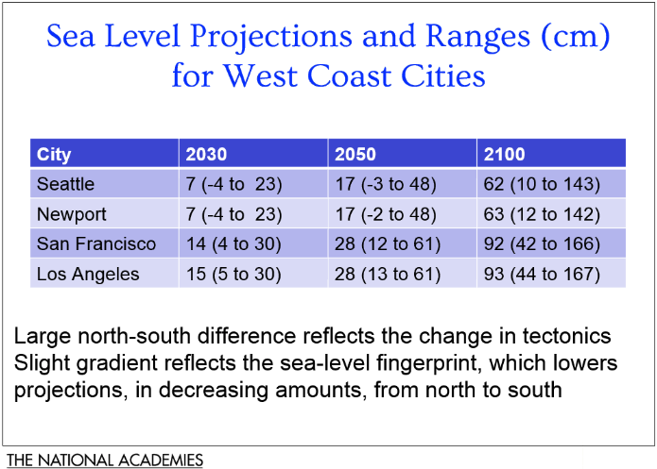
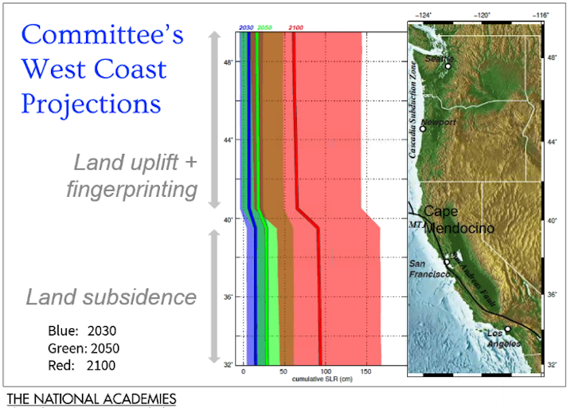
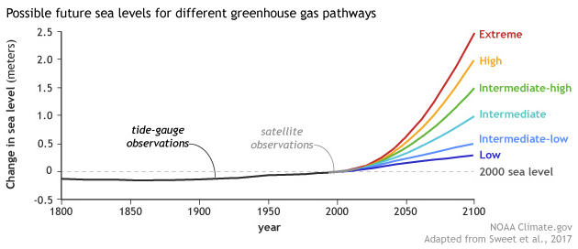
Example Sea Level Rise Projections
Source: Sea-Level Rise for the Coasts
of California, Oregon and Washington,
2012, nationalacademies.org
Projections have changed over time -- impacts are expected sooner than first thought.

Slide 5
Climate impacts and risks – difficult to quantify but manageable
The past is not useful for forecasting climate impacts and risks
However, likelihood and potential significance are now estimable
scientific data are available for all regions and most discrete locations
experience of others provides a learning curve
standard processes are available to guide actions
Impacts and risks are determined by the location of assets
assets can be mapped, valued and prioritized
impacts and risks can be scaled and categorized
coordination with stakeholders will identify vulnerabilities
outreach will align idealized visions with local realities
This is not too new, too big, or too uncertain to worry about.

Slide 6
Managing Climate Change through Mitigation
Local actions to help control a global problem
Example - reduce carbon accumulation in the atmosphere
  transition to more efficient energy sources and buildings
  controlling CO₂ and methane emissions
  buying (or selling) reduction credits
Global intent with local benefits
  lower cost from efficiency improvements
  positive reputation effects with stakeholders
  Improved standing in competitive marketplace
Mitigation is increasingly a competitive and compliance requirement

Slide 7
Managing Climate Change through Adaptation
Actions taken to control, avoid or benefit from local impacts
Often viewed as “sustainability” or “resilience” – examples:
  hardening and elevating assets and expanding drainage capacities
  ensuring continuity of operations and supply chain
  outreach to enhance stakeholder preparedness
Benefits the organization usually with little global intent
  safer and more productive operations, future cost and risk avoidance
  long term needs addressed over time in routine O&M and capital budgets
  lower insurance costs and more favorable bond ratings
  leadership position with suppliers, customers and in the community
Adaptation Challenge - balance risk likelihood & significance with action cost & benefit

Slide 8
Managing natural hazard risks is routine and familiar
Threat | Example Impacts and Risks | Example Management Tools
Earthquakes | Loss of life and injury Infrastructure damage and loss Property damage and loss Higher insurance premiums | Risk maps Institutional and engineering controls; structure retrofits Early warning arrays and alerts; public education Insurance
Flooding |  | Risk maps Institutional and engineering controls Evacuation plans and orders; public education Temporary protection, e.g. berms
Storm surges |  | Risk maps Evacuation plans and orders; public education engineered barriers
Severe winds |  | Structure retrofits; new building code
Fire |  | Hardened structures Evacuation plans and orders Firefighting
Managing climate will rely on similar engineering and institutional controls.

Slide 9
Climate concerns – adaptation challenge examples
Threat | Example Impacts and Risks | Example Management Tools
Sea level rise / more frequent severe storms | Saltwater intrusion and higher groundwater More frequent inundations Groundwater fouling Corrosion Infrastructure dislocation Impaired use of property/resources Weakened financial asset valuations | Engineered barriers Relocation of assets Building code restrictions Public notices, evacuation orders and recovery Adjusted bond maturities Higher insurance premiums “Managed retreat” First mover/leaver advantages
Extreme temperatures | More damaging weather events HVAC energy consumption Geographic ecosystem shifts Depletion of water sources Reduced land productivity Weakened financial asset valuations | Weather forecasts Design changes and engineering controls Public notices, temporary safeguards “Managed retreat” First mover/leaver advantages
CO₂ levels | Ocean acidification/heating Reduced shellfish fecundity Degraded coral ecosystems Weakened financial asset valuations | Relocate assets, e.g., shellfish aquaculture Ecosystem enhancements
Others?
Threats may become opportunities if anticipated and timely managed.

Slide 10
Climate Effects – Coastal Margin Example
Sea level rise - includes accentuated storm surges and king tides
  passive inundation and kinetic impacts
  saltwater/groundwater intrusion
  infrastructure damage (acute or chronic loss, e.g., failure or corrosion)
  water resources (loss or degradation of supply, e.g., irreversible salinity taint)
  remediation site failures, contaminant dispersion
  historic/archaeological/aesthetic resources compromised or lost
Ocean surface temperature - storm precipitation and wind intensity
Land temperature - agriculture and water sources
Ocean acidification - nutritional resources, businesses
Ocean circulation - regional and seasonal weather patterns
Scenarios will have many variables – example combinations:
saltwater intrusion may compromise multiple assets.
both intrusion and surge damage may impact a single facility/asset.
multiple effects may compromise several facilities and access to resources.

Slide 11
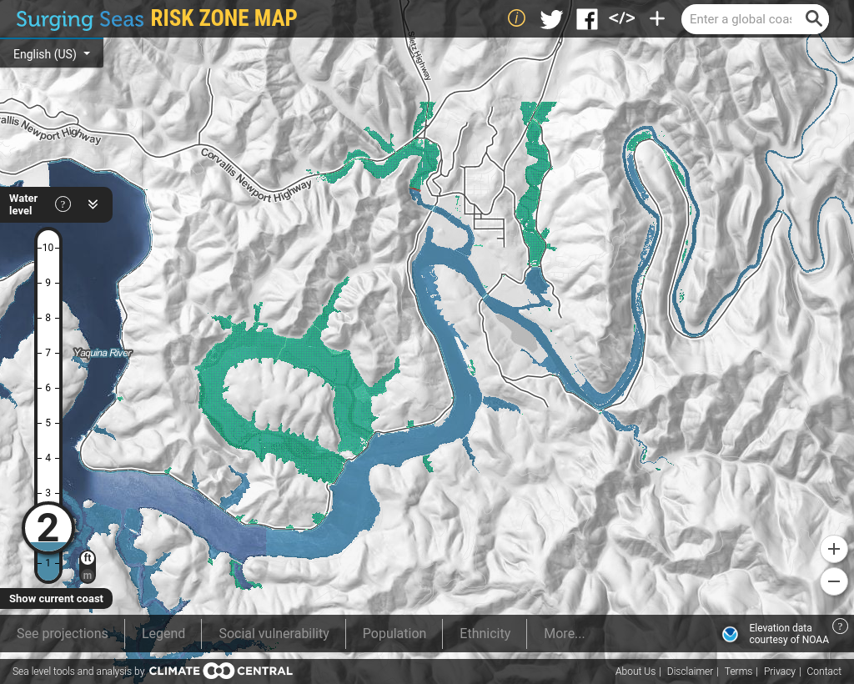
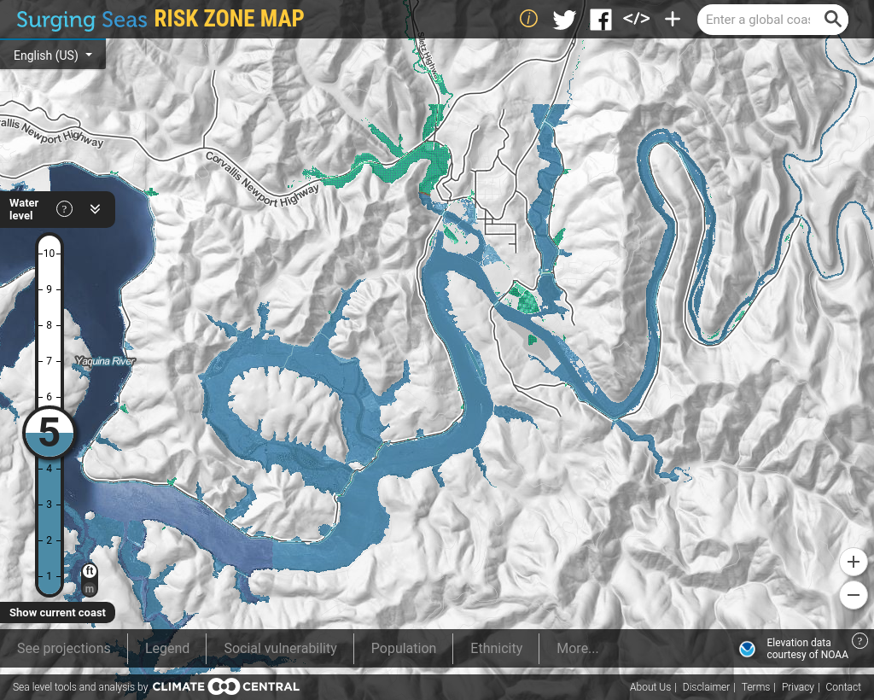
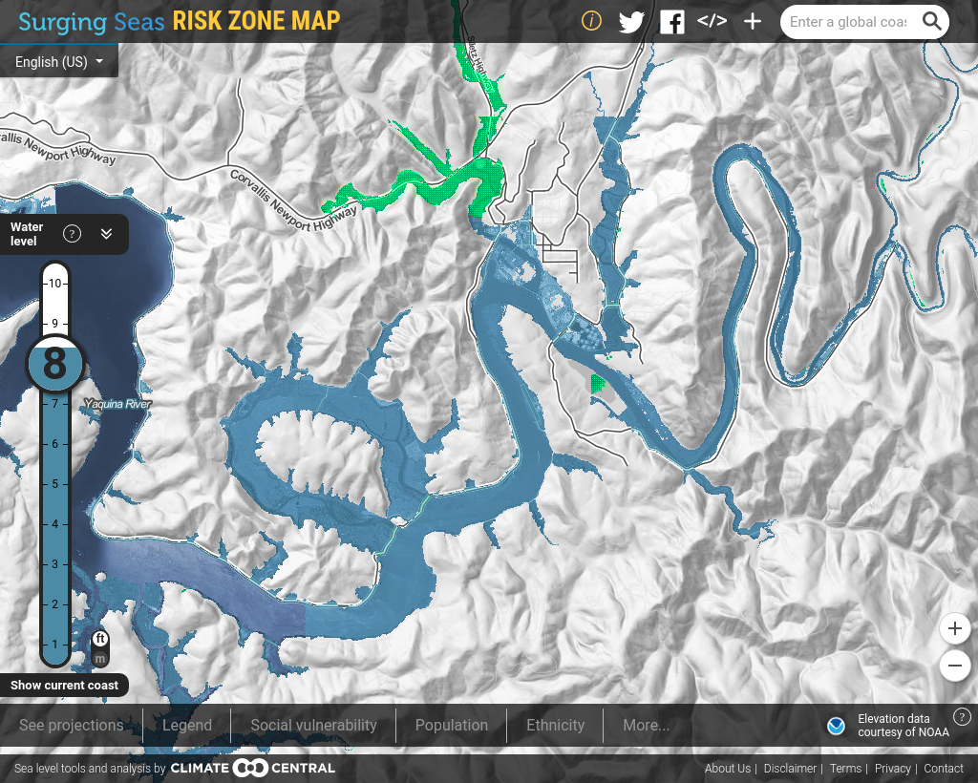
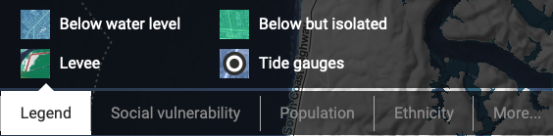
Example tool for Static Sea Level Rise –
Newport, OR (a non-local example)
Example Source:
ss2.climatecentral.org
11

Slide 12
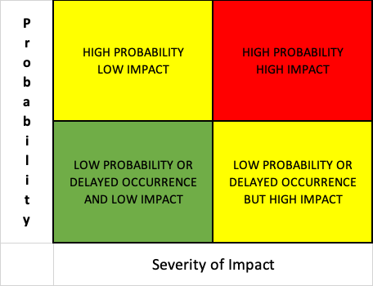
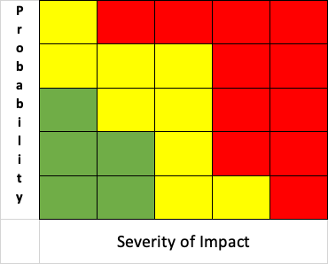
Managing Climate Impacts and Risks – Example Decision Frameworks
Assess
understand risk mechanism (form, likelihood, extent, immediacy)
define valued assets at risk (cost and schedule of impacts)
Prioritize for Risk, Cost and Benefit of Action
prepare plan and estimates for initiatives to manage concerns
tailor risk mitigation priorities to sustainability objectives
approve plan components and sequence to implement
Plan and Decide
implement initiatives and evaluate progress
Act, Track and Update
update conditions, priorities, objectives and plan
1
3
4
2
Action may be to take no action but to monitor and annually update stakeholder risk assessment.

Slide 13
Emerging Environmental, Social and Governance (ESG) Factors
A Definition:
ESG factors refer to an approach for evaluating organizations on their commitments to and success in achieving a responsible and sustainable future for themselves and the earth.
How ESG Factors were established:
The three long-standing ESG issues were consolidated into a single framework to provide a more uniform measure of the behavior and financial performance of publicly-traded companies.
End Users of ESG Data:
While first intended to inform decisions by institutional investors, ESG Factors have come to apply to any organization that commits to incorporating ESG into climate policies and daily practice.
In 2015, the Financial Stability Board established the Task Force for Climate-Related Financial Disclosure (TCFD) to promote reporting on climate criteria.

Slide 14
Brief Overview of Task Force on Climate-related Financial Disclosure
TCFD Objectives and Strategy:
Develop a set of information queries (“indicators”) for use by companies to uniformly provide financial information to investors, lenders, insurers and other stakeholders.
Provide a central clearinghouse for sharing knowledge on means and methods for the accounting of climate-related risks on financial statements.
Include disclosure of how companies establish, commit to and resource action in support of climate sustainability.
Include publicly–traded businesses and government and non-governmental organizations.
Market access to data drives individual Mitigation and Adaptation efforts and global progress.
Source: TCFD 2019 Status Report; June 2019 (tcfd.org)
Thousands of organizations have voluntarily adopted TCFD reporting processes.

Slide 15
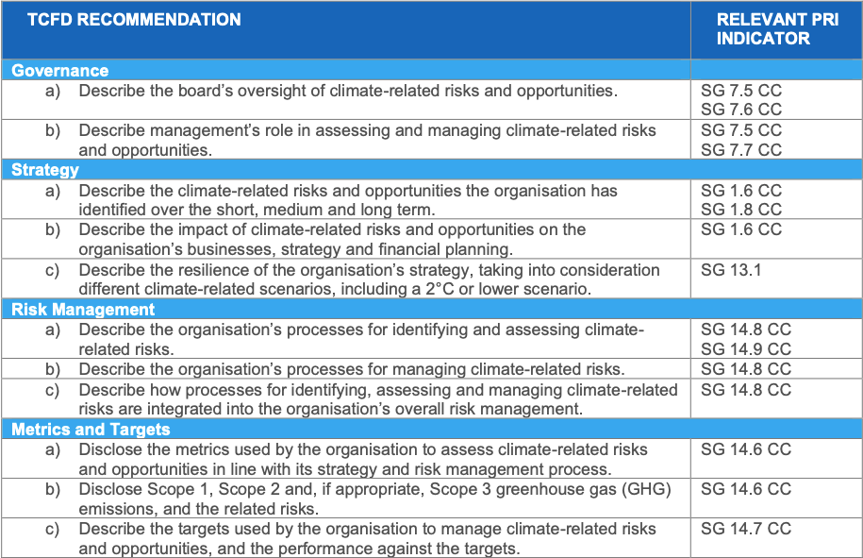
TCFD Recommendations align with Principles for Responsible Investing (PRI) ESG assessment process
Example indicator criteria
Recommended through 2019
Required 2020 and later
“Greenwashing” will always be a problem
Source: unpri.org; PRI Reporting Framework 2019
Strategy and Governance (Climate-related indicators);
November 2018

Slide 16
Quick Summary – Climate Due Diligence for Your Organization
Changes in weather and climate may come at us sooner than we think.
Impacts and risks are very location- and asset-specific.
Data, tools and the experience of others are available around which to plan.
Stakeholders and many others now expect timely climate management.
Globally-accepted ESG standards for managing climate are available.
A monitored risk baseline will allow better forecasting of future impacts.
Climate change is a problem to solve – it is also an opportunity to manage.

Slide 17
Thank you for watching!
“You never know what is enough unless you know what is more than enough.” - William Blake
“Knowing more than enough is a luxury we don’t have!” – Will Ernst

Slide 18
Notes:

