Slide 1
Managing Climate Change
Conditions and Impacts
Assess, Adapt & Sustain
A process for managing climate risks, decisions, plans and actions
DRAFT January 2020

Slide 2
Managing Climate Change Impacts
Presentation content:
The situation we’re in
Changes in natural hazard conditions already occurring in places
Known natural hazards and how they are currently being managed
Process for managing complex and uncertain climate change conditions
Process applied to local hypothetical scenarios
Preview: it’s all about data & location, location and location.

Slide 3
Changing climate conditions: hard to predict, but manageable
It is difficult if not impossible to forecast where or when most adverse events will occur, or when incremental changes will become material.
However, trends in data increasingly define where adverse conditions will occur and the types of risk and extent of damages they will cause.
Specific adverse events and impacts are largely determined by location.
Any organization can adapt by characterizing and planning for the risks involved.
Changing conditions are no longer a risk but an emergency for many regions.

Slide 4
The past is not a good predictor given a rapidly-changing present.
Regardless of cause:
Historical records of many natural conditions are increasingly not useful when forecasting risks and impacts.
A statistician would say “Stationarity is dead!”
But while there is no recent human experience on which to rely, we believe past societies have declined or failed due to a changing climate.
Time frames and extent are often uncertain, but possible impacts are increasingly estimable and probable.
Planning can build on increasingly robust data sets
and real-time experience of others.

Slide 5
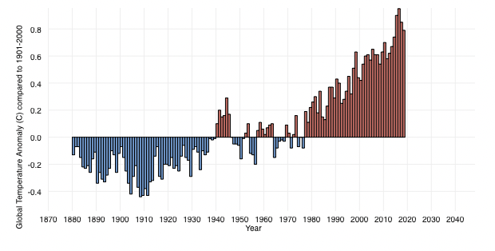

Global average temperatures demonstrate trend of worldwide temperature increases.
Data are plotted relative to a 1901-2000 average.

Slide 6
CO₂ levels, relative to data on periods of prior glaciation, infer trending temperature increases.

Slide 7
Message: data on global temperatures trend higher but demonstrate significant regional and local variability.

Slide 8
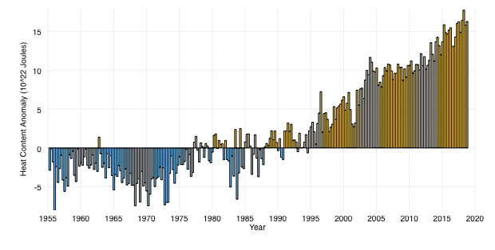
Global average ocean temperatures indicate trend of worldwide temperature increases.
Data are plotted relative to a 1955-2006 average.

Slide 9
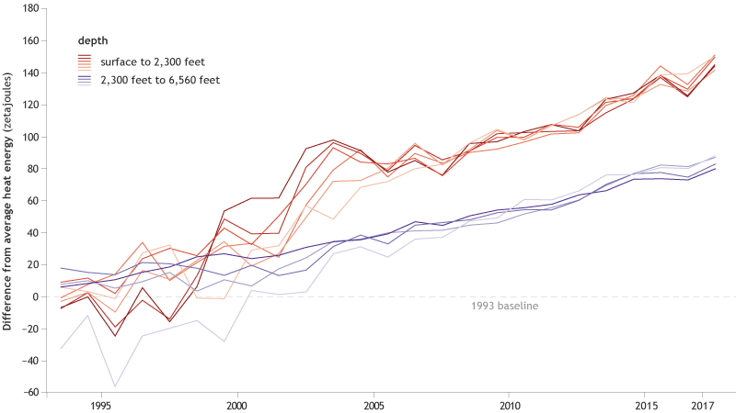
Ocean temperature changes throughout the water column demonstrate heat transfer effects over decades.
Approximately 90% of the heat that has accumulated globally over the last 50 years heat has been retained by ocean waters.

Slide 10
Message: data on ocean temperatures indicate significant regional and local variability.
Data are averaged over 700m of water column surface.

Slide 11
Sea level increases are due to both meltwater and thermal expansion effects.
Separate meltwater and thermal expansion effects on sea level rise
will vary regionally, but over time these effects will combine on a
more global scale due to ocean circulation mixing.

Slide 12
Message: sea level changes occur with unique regional and local extents, frequencies and impacts.
Regional ocean temperature variations, the more local storm surge and tidal effects, and extent of development compound the scale of impacts on the coastal margins.

Slide 13
Trends amplify feedback loops amplify trends …..
Feedback loops increase likelihood that rate of changes will accelerate; examples:
Warming tundra and peat permafrost exposes organic matter to decay and release of CO₂
Reduced sea ice extent causes less albedo reflection of solar radiation and warming water
Drier soils lose evaporative cooling effect, and absorb ongoing solar heat more readily
Loss of natural buffers, primarily through development or storm damage, increases vulnerability to additional losses during future weather events
Some effects spread globally, others occur as regional or very local impacts.

Slide 14
Is all of this too big and uncertain to worry about? - EMPHATICALLY NOT!
At least when considering local effects:
Data may be applied to specific locations to assess potential impacts
Vulnerable physical infrastructures may be mapped
Scale and immediacy of the risk of impact may be estimated
Compromised financial investments and debt rating exposures may be categorized
Adaptations to risk may be assessed against management sustainability objectives
Actions that satisfy objectives may be approved, planned and budgeted in detail
Plans may be implemented, and checked against new data and objectives
There is nothing new about preparing for unpredictable events.

Slide 15
Current natural hazard threats and response analogs
Threat | Risks and Impacts | Example Impact Management Tools
Earthquakes | Loss of life and injury Infrastructure damage and loss Property damage and loss Higher insurance premiums | Risk maps Institutional and engineering controls; structure retrofits Early warning arrays and alerts; public education Insurance
Flooding |  | Risk maps Institutional and engineering controls Evacuation plans and orders; public education Temporary protection, e.g. berms
Storm surges |  | Risk maps Evacuation plans and orders; public education engineered barriers
Severe winds |  | Structure retrofits; new building code
Fire |  | Hardened structures Evacuation plans and orders Firefighting
Known hazards require commonplace engineering and institutional controls.

Slide 16
Process applied to known risk example – adapting to earthquakes
Assess
  Locations at risk, e.g., Pacific Northwest subduction zone; San Andreas sideslip fault; localized faults
  Assets at risk, e.g., transportation system ruptures, building structural failures, tsunami inundations
Decide
  Categorize and establish values for asset risk scenarios
  Prioritize scenario actions against public policy and management objectives
Plan
  Short term – resource response plans, public education, drill alert and response systems
  Longer term – building code revisions
Act
  Implement, gain approvals, allocate budget, perform to plan
  Evaluate plan effectiveness, incorporate new data, and update
For any risk: compile and evaluate the data, and then manage to what you know.

Slide 17
Emerging natural hazard threats and responses - examples
Threat | Example Risks and Impacts | Example Impact Management Tools
Sea level rise / more frequent severe storms | Saltwater intrusion More frequent inundations Groundwater fouling Corrosion Infrastructure dislocation Impaired use of property/resources Weakened financial asset valuations | Engineered barriers Relocation of assets Public notices, evacuation orders and recovery Adjusted bond maturities Higher insurance premiums
Extreme temperatures | More damaging weather events HVAC energy consumption Geographic ecosystem shifts Depletion of water sources Reduced land productivity Weakened financial asset valuations | Weather forecasts Engineering controls Public notices, temporary safeguards
CO₂ levels | Ocean acidification/heating Reduced shellfish fecundity Degraded coral ecosystems Weakened financial asset valuations | Carbon release reductions & sequestration Relocate assets, e.g., shellfish aquaculture
Others?
Threats may become opportunities if anticipated and timely managed.

Slide 18
Process for adapting to any changing climate condition and risk
Assess
  Potential locations, causes, magnitudes and time scales of changing conditions
  Assets relative to risks and potential impacts (e.g., capital and maintenance costs, lower productivity, insurance/financial instrument risk posture)
Decide
  Prioritize objectives and asset-risk scenarios to manage
Plan
  Design contingency measures and investment strategy to best mitigate risks
Act
  Gain support for and implement plan
  Measure progress toward plan and periodically update against new data
Steps build on an organization’s current team and knowledge.
Which changing conditions already, or will, apply to you?

Slide 19
Focus: Climate Change Effects in the Coastal Margin
Sea level effects on storm surges and king tides
  kinetic impacts
  saltwater intrusion
  infrastructure damage (acute or chronic loss, e.g., failure or corrosion)
  water resource quality (loss or degradation of supply, e.g., irreversible salinity taint)
  contaminant dispersion
  historic/archaeological/aesthetic resources compromised or lost
Ocean surface temperature effects on storm intensity
Ocean acidification effects on nutritional resources
Ocean circulation effects on regional and seasonal weather patterns
An analysis may generate multivariate risk impact scenarios:
Saltwater intrusion may compromise multiple assets.
Potential for both intrusion and surge damage may impact a single facility/asset.
Multiple climate effects may compromise several facilities and access to resources.

Slide 20
Managing Impacts from a Changing Climate – Example Decision Frameworks
Assess
Understand risk mechanism (form, likelihood, extent, immediacy)
Define valued assets at risk (cost and schedule of impacts)
Tailor risk mitigation priorities to sustainability objectives
Decide
Prepare detailed plan and budget estimates to address objectives
Approve plan components and sequence to implement
Plan
Implement and evaluate
Act
Update conditions, priorities, objectives and plan

Slide 21
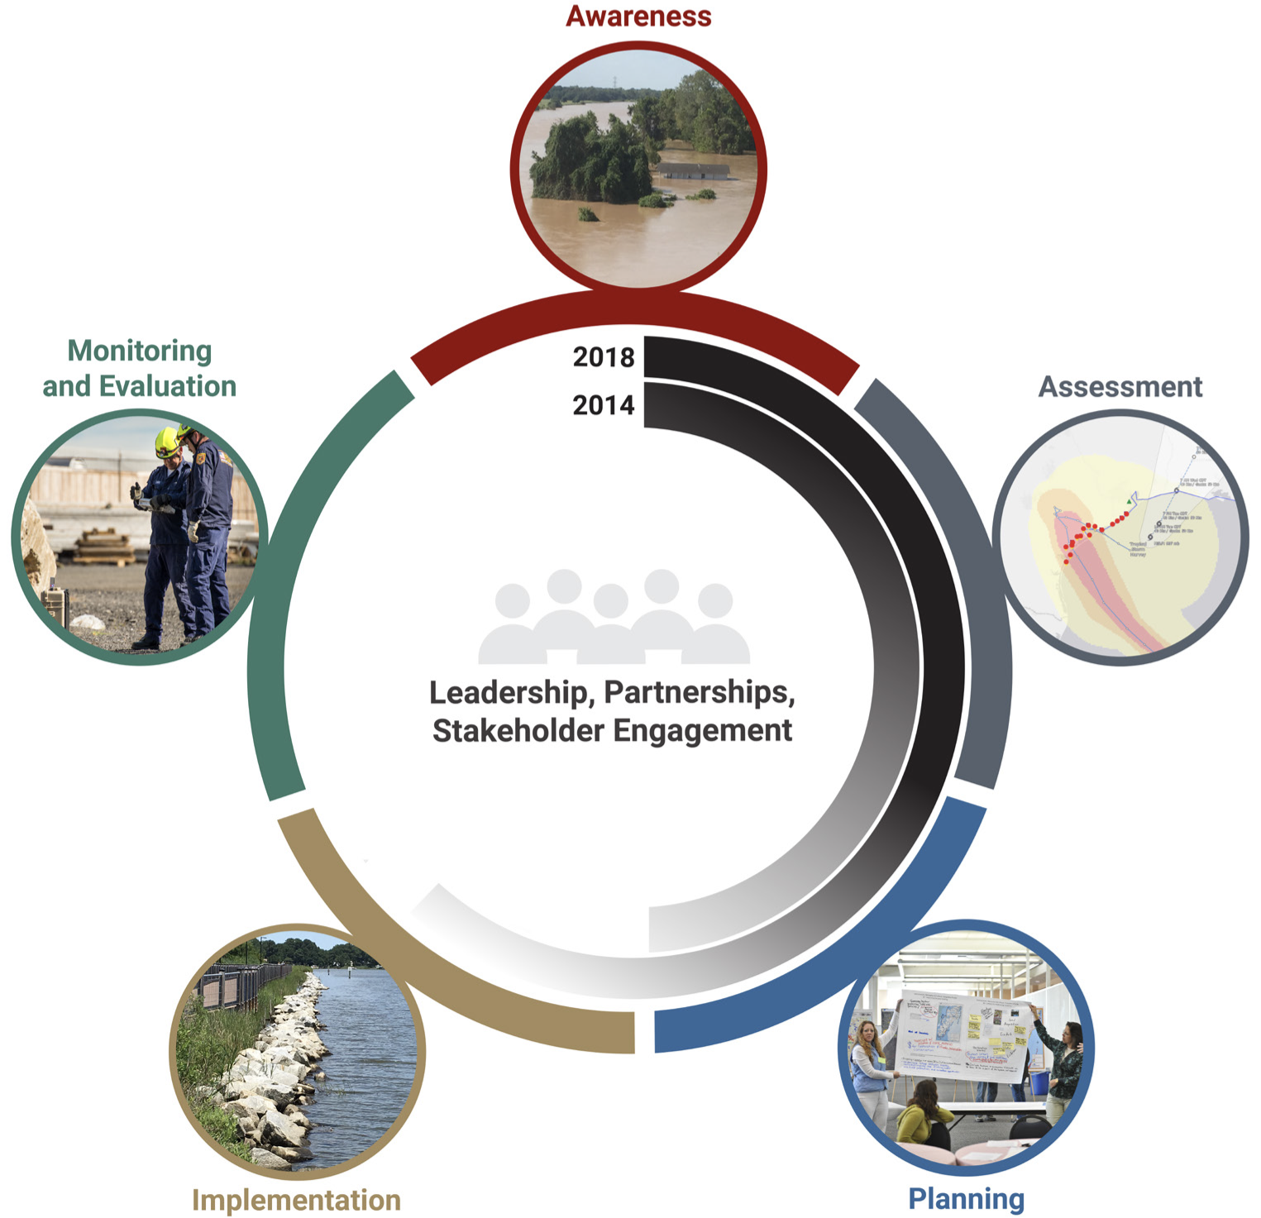
Extensive work has been completed for use in guiding actions.
Example:
“Five Adaption Stages and Progress”
Source:
Fourth National Climate Assessment
Volume II Impacts, Risks, and Adaptations in the United States
U.S. Global Change Research Program, 2018

Slide 22
Hypothetical examples – a “back of the envelope” focus
Charleston SC harbor brownfields property - draft
Coastal community – in work
Highly simplified examples demonstrate process to be applied to specific projects.

Slide 23
Hypothetical Brownfield Property, Charleston SC
Setting and situation:
Industrial property built on filled wetlands and intertidal mudflats, predominant elevation + 7’ (average elevation of City is 4’)
Harbor waterfront property in a thriving metropolitan area
Clear potential for rising property values and a high-rise residential property
Prospective buyer is considering significance of potential range of climate impacts
  Frequency and magnitude of flooding affecting design parameters for redevelopment
  Impact of weather events on residents’ property use and access/egress
  Effective lifespan of investment and prospects for insurance and financing
Buyer due diligence
  Assumptions to support design alternatives and investment viability (50-year design life)
  Concerns potentially exhibited by retail/apartment tenants or condominium owners
  Permitting and public sustainability conditions
Charleston chosen as example due to history of recent sea level rise and flood events and civic commitment to address risk and impact forecasts.

Slide 24
Hypothetical Brownfield Property – Climate Setting
Climate risk factors affecting due diligence planning assumptions:
In 2015, City recommended elevating new facilities and infrastructure 1.5 to 2.5 feet to account for projected sea level rise over 50 years. In 2019, recommended increase was revised to an increase of 2 feet for less critical facilities and 3 feet for critical longterm infrastructure, such as medical facilities.
Based on an accelerating rate of sea level increase recorded over the last 20 years, and an increase in storm intensity and flood events exceeding +9’MSL (estimated as potentially occurring every other day by 2045).
City initiatives in response include improved civic roles and infrastructure:
Infrastructure: Sea wall barrier, drainage capacity, drainage system maintenance, flood control valves, elevating critical structures
Governance and coordination: emergency response capacity, Community Rating System to facilitate FEMA insurance applications, mitigation and recovery support, zoning changes, ongoing planning
Source: City of Charleston “Flooding and Sea Level Rise Strategy | A Strategic Plan”
Extensive analysis for Charleston area also supports project-specific risk evaluations.

Slide 25
Hypothetical Brownfield Property – Due Diligence Factors
  Design considerations to account for climate change risks:
  Increasing elevation, adding storm barriers, expanding drainage control systems
  Location and hardening of building systems and features
  Access/egress for residents and service providers
Marketing, insurance and financing considerations:
  Documentation of climate-induced risks in prospectus
Permitting considerations:
  Responsible designs and safety preparedness to not burden public resources
  Adhere to zoning and sustainability ordinances
City of Charleston has committed to extensive sustainability measures with supporting data, similar to what may be prepared for any project location.

Slide 26
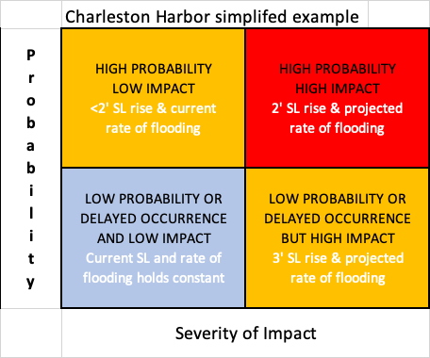
Hypothetical Brownfield Property – Decision Framework
Due diligence risk prioritization factors:
Design examples:
Required foundation elevation increase
Precautionary placement of building systems
Constraints for access on area roadways
Insurance examples:
Property location relative to FEMA criteria
Prospectus statement for insurers
Financing examples:
Prospectus statement for investors
Marketability examples:
Prospective tenant/owner concerns
Process task: compile project data to inform cost estimate for each impact scenario.

Slide 27
Hypothetical Coastal Community – US Pacific Northwest
Setting and situation:
Rugged natural areas interspersed with mixed density development along dune and low bank ocean frontage; assorted primary and second homes and low-rise motel accommodations of varying ages; multiple estuarine harbors support raw material exports, fishing, aquaculture and tourism
Average elevations: + 10’ (dunes), +25’ (low bank bluffs), and +10 in cities/harbors
Stable to modest growth mostly supported by now retiree purchases and vacation stays
Responsible jurisdictions include city, county, state and tribal governments.
Stakeholder focus is common hazards potentially amplified by climate impacts
  Higher frequency and magnitude of river/storm surge flooding threatens
  commercial and industrial business districts and residential neighborhoods
  Shore erosion ongoing in some areas but may increase in rate and extent,
  further impacting primarily residential properties, road access and park resources.
  Tsunami inundation extent may increase somewhat due to sea level and storm surge rise
Region chosen as example due to history of shoreline erosion and flooding.

Slide 28
Hypothetical Coastal Community – Climate Resilience Planning
Climate risk factors affecting planning assumptions over 50-year time horizon:
Historic shoreline erosion will continue and may likely spread and accelerate
Emerging hazards requiring consideration:
  Acidification of marine waters impairs vulnerable species, e.g., shellfish, and aquaculture
  Warmer ocean waters and in river systems reduces ecosystem productivity and resistance to disease
Community initiatives in response may include:
Infrastructure: additional flood barriers and flood control valves, increases in drainage capacity and drainage system maintenance, elevating existing critical structures
Governance and coordination: emergency response capacity and mobility considerations, data supporting FEMA insurance applications, mitigation and recovery support, zoning changes
Existing planning efforts may be augmented by long range impact scenarios.

Slide 29
Hypothetical Coastal Community – Due Diligence Factors
  Design considerations to account for climate change risks:
  Increasing elevation, adding storm barriers, expanding drainage control systems
  Location and hardening of building systems and features
  Access/egress for residents and service providers
Marketing, insurance and financing considerations:
  Documentation of climate-induced risks in prospectus
Permitting considerations:
  Responsible designs and safety preparedness to not burden public resources
  Adhere to zoning and sustainability ordinances
City of Charleston has committed to extensive sustainability measures with supporting data, similar to what may be prepared for any project location.

Slide 30
Hypothetical Coastal Community – Decision Framework
Risk prioritization factors:
Design examples:
Required foundation elevation increase
Precautionary placement of building systems
Constraints for access on area roadways
Insurance examples:
Property location relative to FEMA criteria
Prospectus statement for insurers
Financing examples:
Prospectus statement for investors
Marketability examples:
Prospective tenant/owner concerns
Process task: compile project data to inform cost estimate for each impact scenario.

Slide 31
Questions & Discussion
“You never know what’s enough until you know what’s too much” - William Blake
Knowing too much is a luxury we don’t have!

Slide 32
Notes:

